Slide 1
Allogene Therapeutics
Members: Nolan Coetzee, Rose Weinila, Natalie Ramdeo, Brianna Gilbert, and Mazin Bakhit

Slide 2
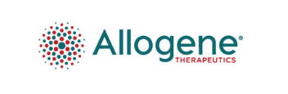
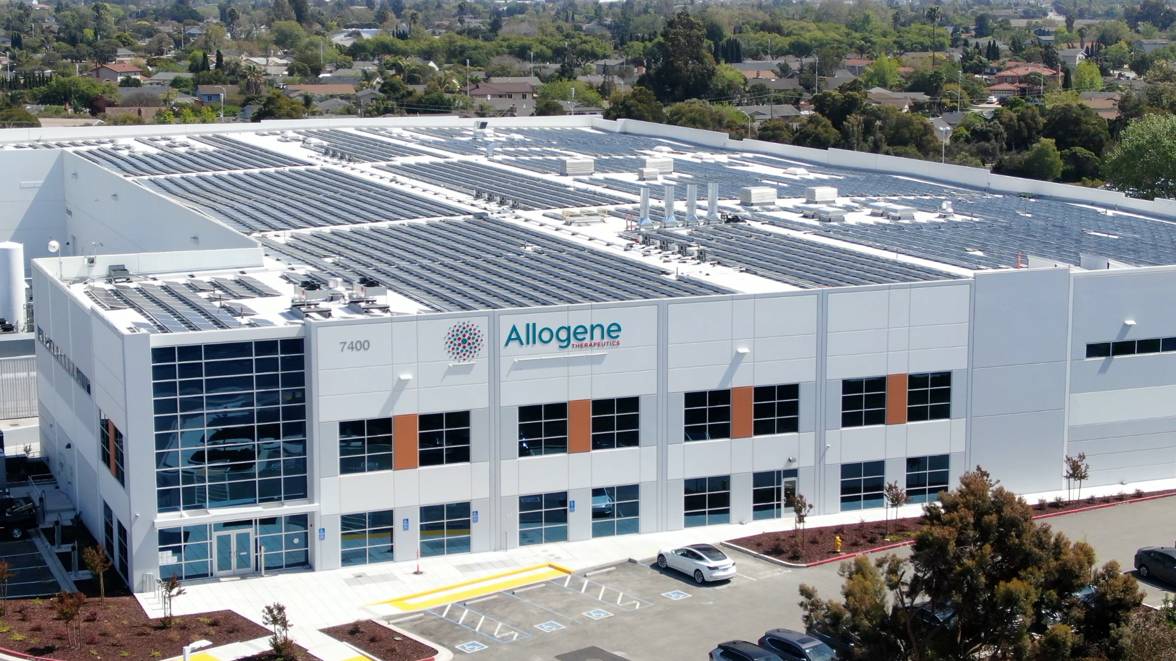
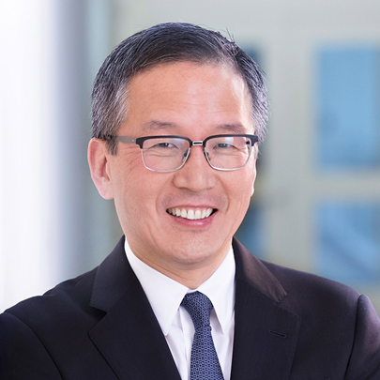
Allogene Therapeutics
“Off the Shelf Cancer Treatment”
Genetically engineered T-Cells
The FDA put them on hold in 2021 due to abnormalities in patient
Founder
David Chang
Notes:
Or in simple terms, they draw blood from healthy man or woman they store their white blood cells, and then they program their white blood cells through gene editing to attack and destroy cancer cells. They then inject these white blood cells or T cells in the patient
SO they are using the power of the immune system to fight against cancer.

Slide 3
Table of Contents
Background
Environment
General
Industry
Current Situation
Financials
Leadership
Strategy
Strategic Leadership
Future

Slide 4


Background
The company is located in San Francisco, California.
The target customer base includes people who are looking for cancer treatment for either themselves or a loved one.
Notes:
The technology used can vary, but the major technology that they use are a type of pipelines that are used to target and kill cancer cells.
As of the year 2021, Allogene Therapeutics currently has at least 310 employees working for their company.
Out of that number, 308 are full-time.
From that set of full-time employees, 70 of them hold either Ph.Ds and/or M.D degrees. And from the 310 employees, only 234 of them are engaged in the research side of the company.

Slide 5
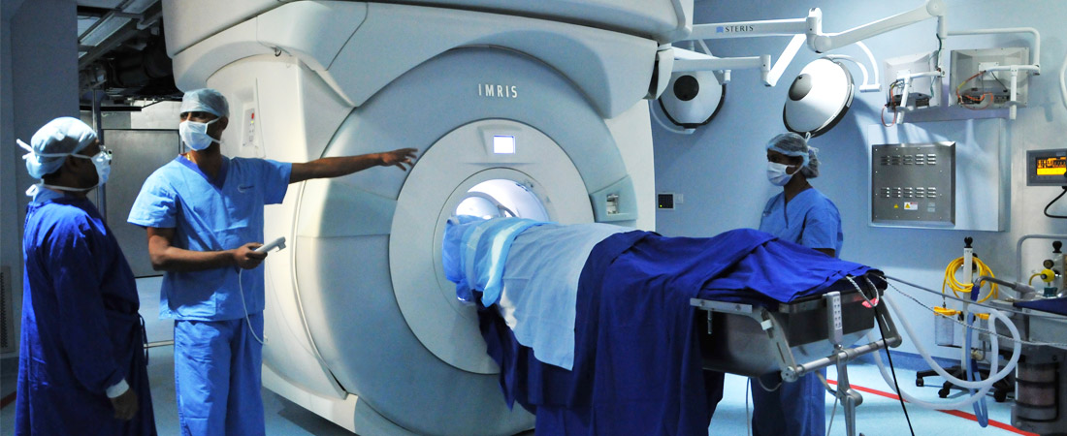
Environment
Cancer is the 2nd most common cause of death
Older population
Debilitating disease and treatment
Highly Regulated
Novel product
Competitors making similar products
Still being researched
Race to the finish
Notes:
leading cause of morbidity and mortality worldwide.
Serious condition that will need medicine and care for a long time

Slide 6

Environment Cont.
Generally non-profitable
Currently
Extremely high potential for profit
Once product hits shelves
Highly Competitive
Relationships
Joint Venture with Overland Pharmaceuticals
Ties to Pfizer
Cellectis supplier a lot power
Notes:
biotechnology industry is highly competitive and subject to rapid and significant technological change.
Fda approval will allow for profit
High Barriers to Entry: start up cost, regulation challenges, specialized expertise
Suppliers have a decent amount of power due to materials needed by these companies like ours (Cooperative alliances:
-lonza: holds and/or has placed orders for Raw Materials purchased for use with Services that were to be provided to Allakos)

Slide 7
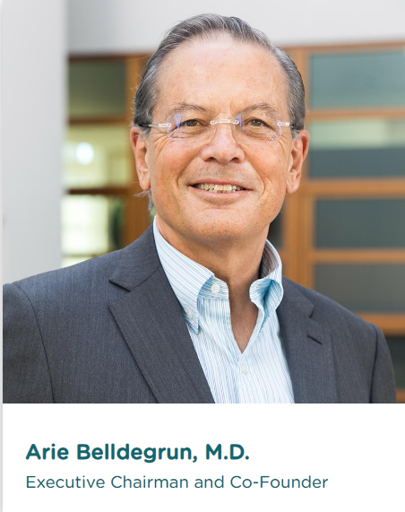
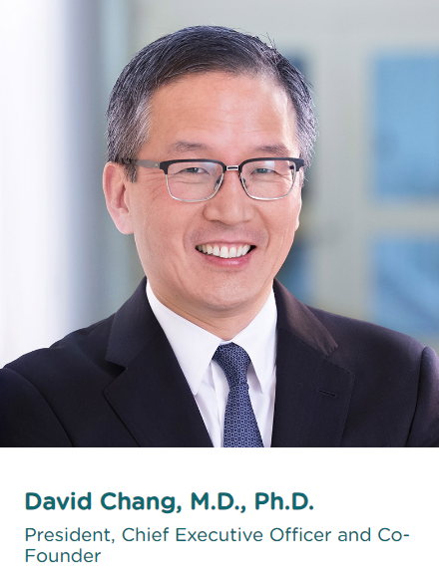
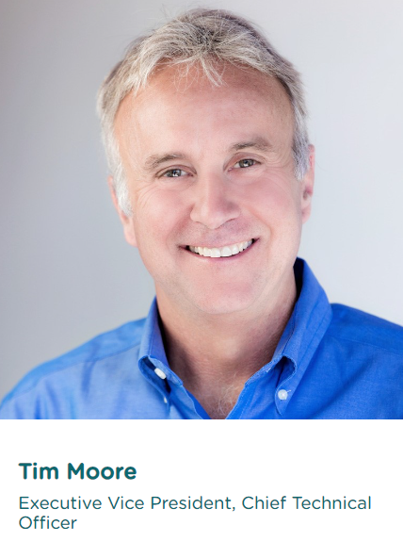
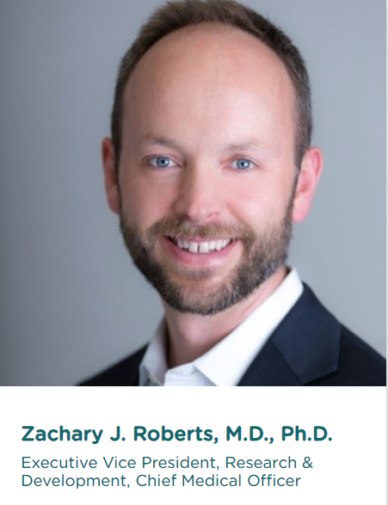
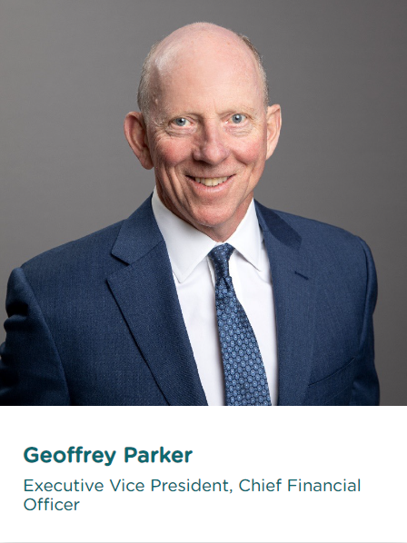
Board of Directors
Varied expertise in industry
Ivy League MDs and PHDs
Biotech, Chem Engineering, Biology, Economic etc
Demographically similar
Older, white, mostly male
Academics
Diversity adds performance boosts
Notes:
From our reading, we understand that heterogeneity within top management will encompass diversity in aspects such as gender, experience, education, and professional background. We believe that a diverse executive is vital to enhancing organizational performance. After examining Allogene’s annual reports, we established that the company’s top management exhibits heterogeneity concerning, age, gender, experience, and education. In fact, our analysis showed that the company’s top management team is composed of qualified people from a diverse background. For example, David Chang, who is the company’s CEO is 63 years and has extensive experience in biopharmaceuticals. The CEO, who doubles as the company president, has BA in biochemistry from Harvard university. Alison Moore, who is the company’s executive vice president, has a wealth of experience in clinical devilment. This diversity in age, gender, experience, and education we believe allows the name executives members to bring forth their unique experiences and perspectives, enriching the organization's leadership.

Slide 8
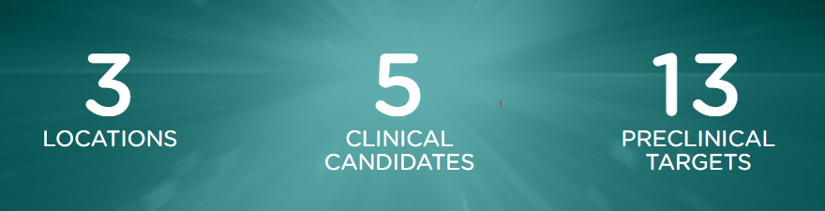
Financials
2018-2021 | Allogene | Industry Average
Return on Assets | -24.53% | -12.25%
Return on Equity | -27.65% | -17.25%
Operating Profit Margin | -1276.79% | -46.00%
Current Ratio | 1277.32% | 522.50%
Debt to Assets | 11.34% | 31.75%
Debt to Equity | 12.81% | 46.50%
Allogene has raised a total of $901.8 million dollars in four rounds of funding - “Crunchbase”
Alloegene Therapeutics has yet to be approved for any of its products.
Notes:
Since 2020 stock has gone from 54 to 3 dollars

Slide 9
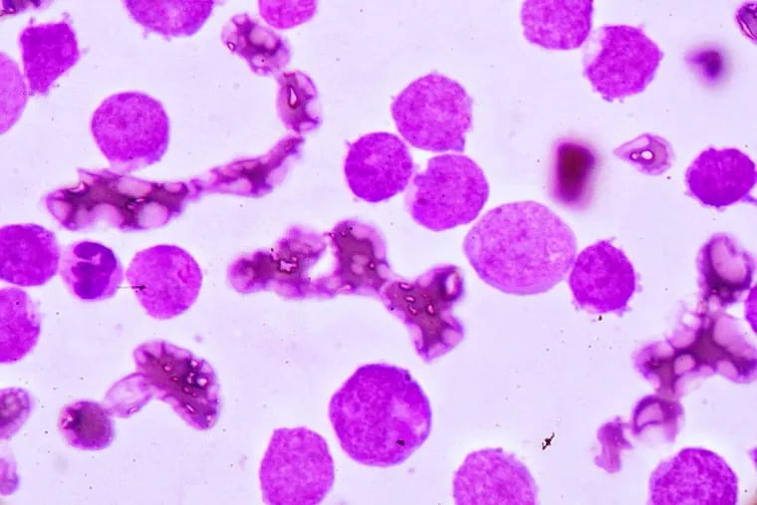
Allogene’s Strategy
CAR Therapy
Unique product differentiates
Single Focus
Getting product to market
Research takes time
Approvals
FDA
EMA
GDPR
Notes:
Food drug administration
European medicines agency
General Data Protection Regulation

Slide 10
Strategic entrepreneurship
Entrepreneurial Pursuits
Focus on Advancement
Strategic Collaborations:
Risk Embrace
Notes:
We see the company's dedication shining through their annual report. They're all about seizing opportunities, especially in creating treatments for cancer known as allogeneic CAR T therapies. They've shared detailed plans on how they're investing in these therapies to help those battling cancer.
What's impressive is how they're teaming up with different groups, almost like building a team of superheroes, to make big changes. It shows just how much they want to innovate and make a difference in their field.
But here's the challenge—they also have to navigate the rules in healthcare and biotech. These rules can slow down their progress. So, it's crucial for them to ensure that their brilliant ideas fit within these rules to really make it work

Slide 11
Future
Currently:
Little control
50/50
Highly dependent on external environment
Potentially:
High control
Chance skewed in their favor
Agency
Notes:
What could happen if allogene continues as they are
and
What could happen if allogene adopts to our suggested changes

Slide 12
Suggestions
Hyper Focus on FDA Approval
Diversify Leadership and Workforce
Enter agreements with suppliers to gain control
Notes:
3 points
Hyper focus on to getting FDA approval
(this is the main barrier between allogene and profitability, allowing allogene to sell their products would result in huge profit margins and control over the industry)
Diversify leadership and consequently labour force
(the leadership in this company are a monolithic group trying to discover and implement something new, it would be beneficial to gain new eyes and ideas to give allogene a competitive advantage against its competitors)
Enter Strategic Alliances with suppliers
(while the industry is highly competitive, making alliances both unlikely and highly risky, alliances with suppliers would give allogene an advantage while hindering other competitors attempting to beat Allogene to the finish line)
Enter the traditional Cancer treatment industry
(maintaining research in the CAR T while adding traditional treatments to their product mix would allow allogene to keep it’s head above water. It would also allow for more information for research)

